Slide 1
Machine Learning Techniques (16CSE09)
Unit – 1 / Sessions: 5, 6, & 7

Slide 2
Course objective-1: Describe Various Machine Learning Approaches.
Topics:
Machine Learning Algorithms Grouped by Learning Style
Machine Learning Algorithms Grouped By Similarity
At the end of this session, students will be able to know the various ML algorithms based on learning style and the similarity between them.

Slide 3
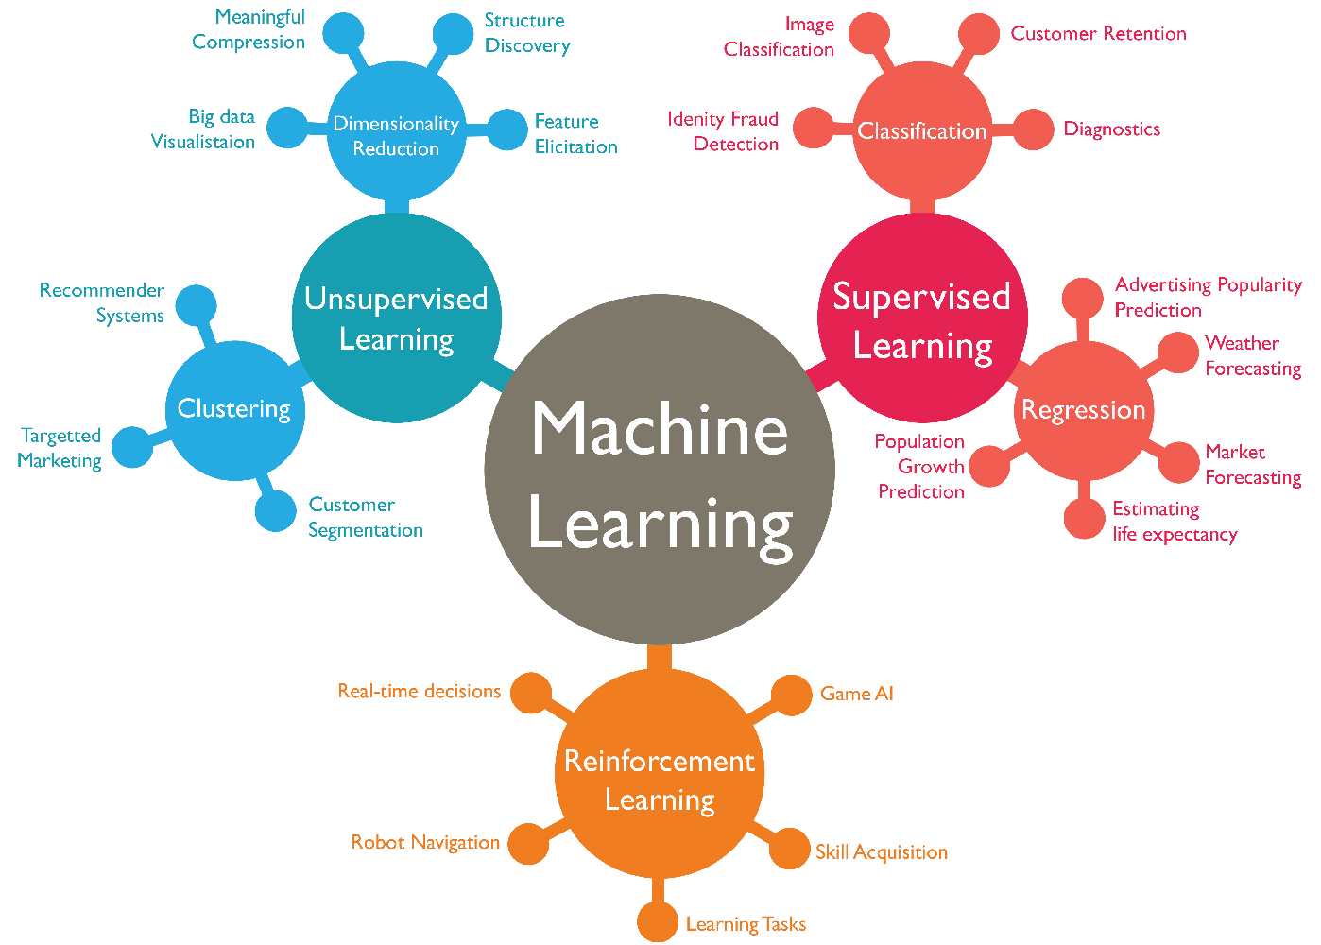

Slide 4
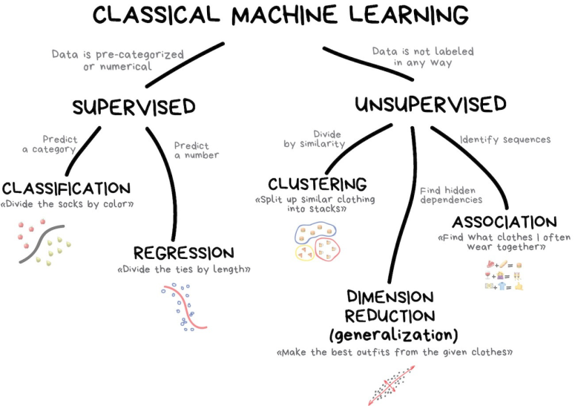

Slide 5
Machine Learning Algorithms Grouped by Learning Style
Supervised Learning
Classification
Regression
Neural Network
Unsupervised Learning
clustering, dimensionality reduction or dimension reduction, is the transformation of data from a high-dimensional space into a low-dimensional space so that the low-dimensional representation retains some meaningful properties of the original data, ideally close to its intrinsic dimension.
association rule learning: is a rule-based machine learning method for discovering interesting relations between variables in large databases - Apriori algorithm
k-Means: Clustering method

Slide 6
Machine Learning Algorithms Grouped by Learning Style
Reinforcement learning
Chess game
MDP (Markov Decision Processes):
straightforward framing of the problem of learning from interaction to achieve a goal.
The agent and the environment interact continually, the agent selecting actions and the environment responding to these actions and presenting new situations to the agent.

Slide 7
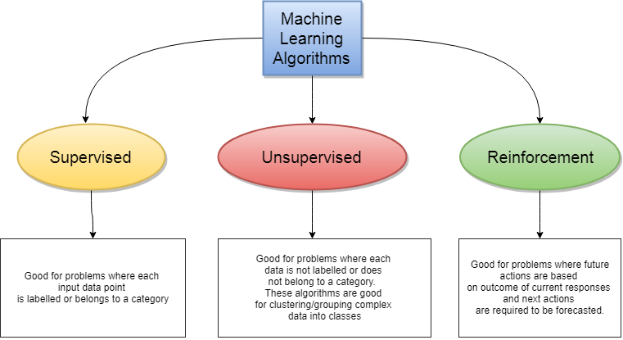
Based on Learning style

Slide 8
Machine Learning Algorithms Grouped By Similarity
similarity in terms of their function
modeling the relationship between variables
Regression Algorithms: attempts to model the relationship between two variables
Ordinary Least Squares Regression (OLSR)
Linear Regression
Logistic Regression
Stepwise Regression
Multivariate Adaptive Regression Splines (MARS)

Slide 9
Machine Learning Algorithms Grouped By Similarity
Instance-based Algorithms
model is a decision problem with instances of training data
k-Nearest Neighbor (kNN): non-parametric classification method
Learning Vector Quantization (LVQ): classification algorithm
Self-Organizing Map (SOM): ANN based dimensionality reduction algorithm

Slide 10
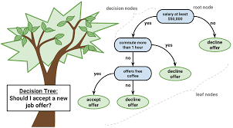
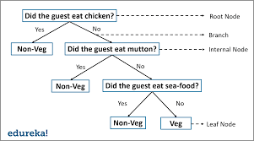
Machine Learning Algorithms Grouped By Similarity
Decision Tree Algorithms: family of supervised learning
Classification and Regression Tree (CART)
Iterative Dichotomiser 3 (ID3)
C4.5 and C5.0 (different versions of a powerful approach)
Chi-squared Automatic Interaction Detection (CHAID)
Decision Stump
M5
Conditional Decision Trees

Slide 11
Machine Learning Algorithms Grouped By Similarity
Bayesian Algorithms
apply Bayes’ Theorem to solve problem
Naive Bayes – classifier
Gaussian Naive Bayes – classification
Multinomial Naive Bayes - classification
Averaged One-Dependence Estimators (AODE) - classification
Bayesian Belief Network (BBN): probabilistic graphical model that represents a set of variables and their conditional dependencies via a directed acyclic graph

Slide 12
Machine Learning Algorithms Grouped By Similarity
Clustering Algorithms
modeling approaches such as centroid-based and hierarchal
k-Medians
Expectation Maximisation (EM)
Hierarchical Clustering

Slide 13
Machine Learning Algorithms Grouped By Similarity
Association Rule Learning Algorithms
learning methods extract rules
Apriori algorithm
Eclat algorithm

Slide 14
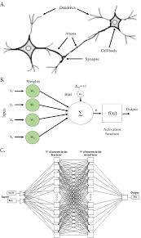
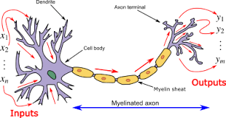
Machine Learning Algorithms Grouped By Similarity
Artificial Neural Network Algorithms
inspired by the structure of biological neural networks.
Perceptron
Back-Propagation
Hopfield Network
Radial Basis Function Network

Slide 15
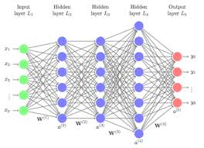
Machine Learning Algorithms Grouped By Similarity
Deep Learning Algorithms
building much larger and more complex neural networks.
Deep Boltzmann Machine (DBM)
Deep Belief Networks (DBN)
Convolutional Neural Network (CNN)
Recurrent Neural Networks (RNNs)

Slide 16
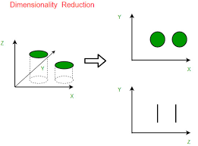
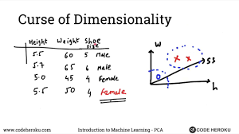
Machine Learning Algorithms Grouped By Similarity
Dimensionality Reduction Algorithms
Principal Component Analysis (PCA)
Principal Component Regression (PCR)
Partial Least Squares Regression (PLSR)
Sammon Mapping
Multidimensional Scaling (MDS)
Projection Pursuit
Linear Discriminant Analysis (LDA)
Mixture Discriminant Analysis (MDA)
Quadratic Discriminant Analysis (QDA)
Flexible Discriminant Analysis (FDA)

Slide 17
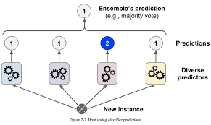
Machine Learning Algorithms Grouped By Similarity
Ensemble Algorithms: ensemble methods use multiple learning algorithms to obtain better predictive performance than could be obtained from any of the constituent learning algorithms alone
Boosting
Bootstrapped Aggregation (Bagging)
AdaBoost
Stacked Generalization (blending)
Gradient Boosting Machines (GBM)
Gradient Boosted Regression Trees (GBRT)
Random Forest

Slide 18
Summary…
In this session we have discussed the
Machine Learning Algorithms based on Learning Style
Machine Learning Algorithms based on Similarity
Thank You…

